Slide 1
Badge Generation portal for Students, College professors & recruiters
THEME : DIGITAL BADGING
TEAM : namoRocks
SUBMISSION : A web portal (Software)
PORTALNAME : Get Your Badge
Link : https://github.com/gitkp11/BadgeProject

Slide 2
Problem statement
Digital badges could be motivating to students and useful to professors by creating a badging system for a youth-focused technology program. It helps professors track their students’ progress. They also equip students with a tool to acknowledge their accomplishments and show what they are learning. There is great potential for badges to be valuable for industry when it comes to hiring competent employees.
Globalshala welcomes you to build a badging platform and enable them to issue digital badges. A platform that can have digital micro-credentials that validate accomplishment, skill, quality or interest. They can be “packaged” in a digital file, represented by an icon. The file may hold the description of the badge, who issued it and the criteria required to receive it.
Example: Badgr

Slide 3
STAGES OF PROJECT
1
IDEAS/THOUGHTS BEHIND PROJECT
Stages
2
IMPLEMENTATION OF IDEA
3
PRESENTATION, OPTIMISATION PHASE

Slide 4
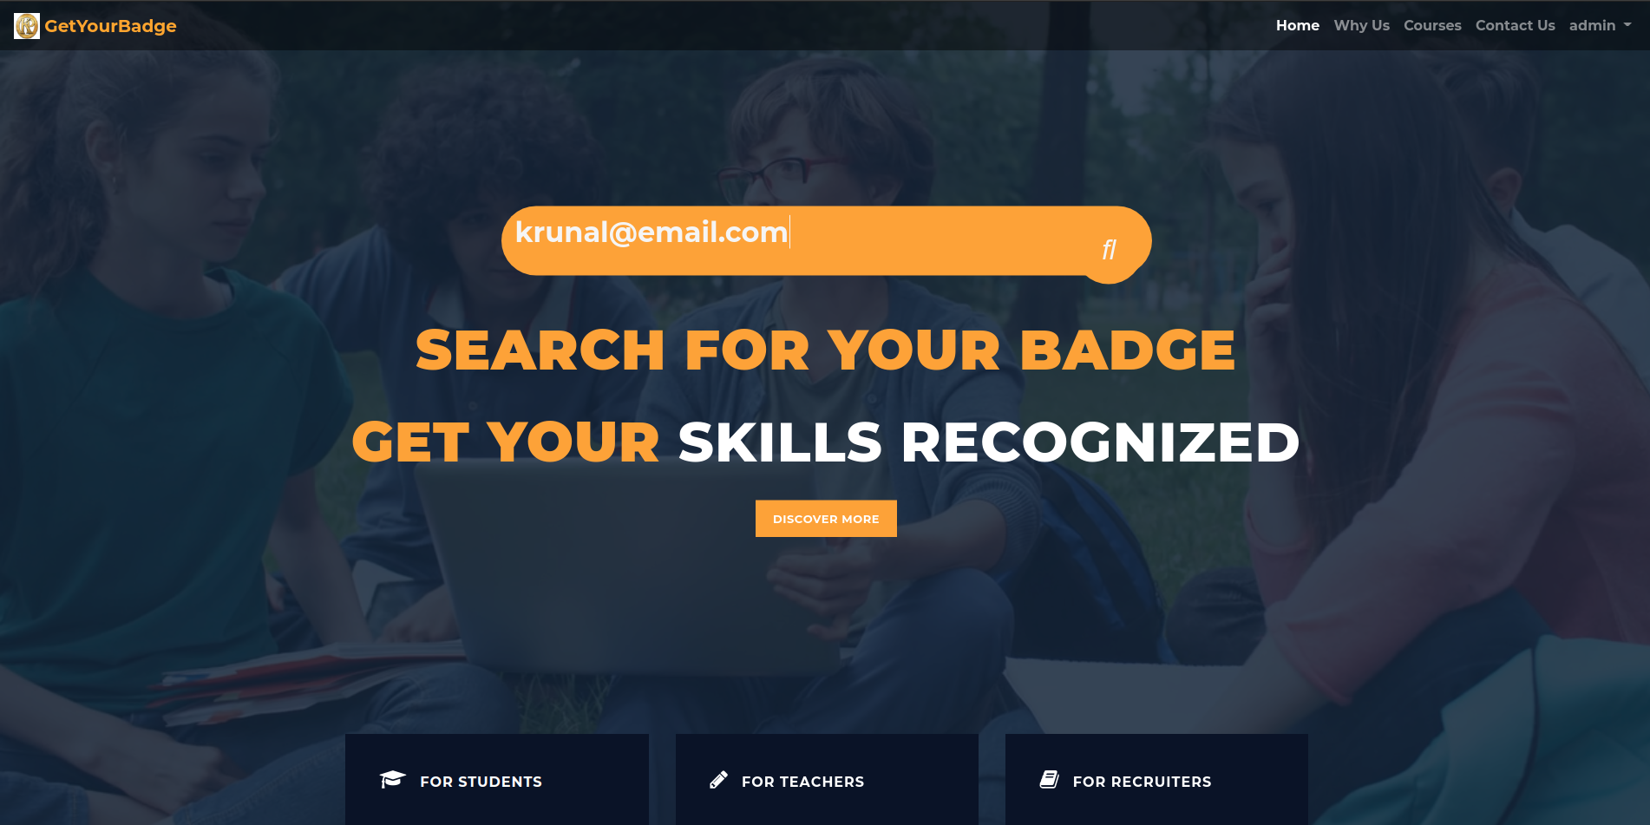

Slide 5
STAGE-I : IDEA
The college students spend their large portion of resources on college courses and gain varying degrees of understanding of these courses.
Keeping college scoresheets aside, there is no medium to authenticate , if some person possesses extraordinary knowledge of some subject.
In other words, there is no “REWARD FOR CONSISTENCY” in college curriculum at present.
So the Idea is to create a portal which can acknowledge student’s semester-long consistency and excellence by rewarding them with badges of excellence
The final authority of badge distribution will lie with respective course teachers.

Slide 6
STAGE-II : IMPLEMENTATION
Badge validation:-
Each professor will provide students mail-id by which a student can visit our portal and enter his mail id. If the student is assigned a badge, its mail-id will be available in the database, by which one can view the badge.
Professor validation:
The professor profile will be verified by the TPO of that particular college via his LINKEDIN id or our web portal account. Once TPO validates the professor profile then only he/she can create custom courses and allot badges to his students.

Slide 7
STAGE-II : IMPLEMENTATION
There will be 3 views to the website:-
1. Teacher View
2. Recruiter View
3. Student View

Slide 8
Teachers view:
STAGE-II : IMPLEMENTATION
Create an account
Can create courses which they teach in their college.
They can allocate badges to certain no of students.

Slide 9
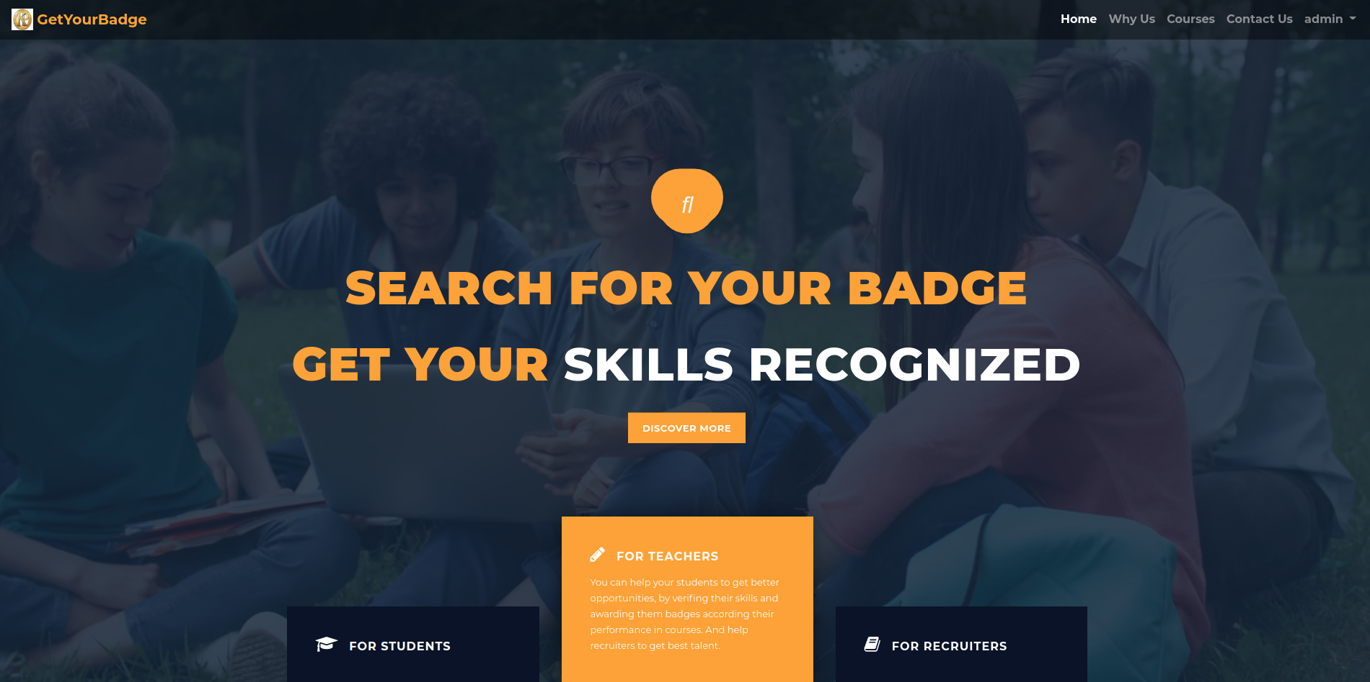

Slide 10
STAGE-II : IMPLEMENTATION
Student VIEW
Students won't be having their account on the portal.
Enter their email id on the homepage. After entering email id if a student is allotted a badge, a digital badge will be created thereby they can download the file or can view it in browser.
We will describe the badge file later in separate slide.
They can compare their skills with other students available on the portal wherein they will get insights of how well prepared they are for the industry.

Slide 11


Slide 12
STAGE-II : IMPLEMENTATION
RECRUITER VIEW:
They will be able to view the homepage where all the courses are listed & in each courses student details, who have been allotted certain badges in respective courses, enhancing their visibility to industry ready student.
They will also be able to view various skills honed by students by having a visibility access to respective GitHub or LinkedIn id’s of students.
They can also directly contact TPO in case of discriprencies.

Slide 13
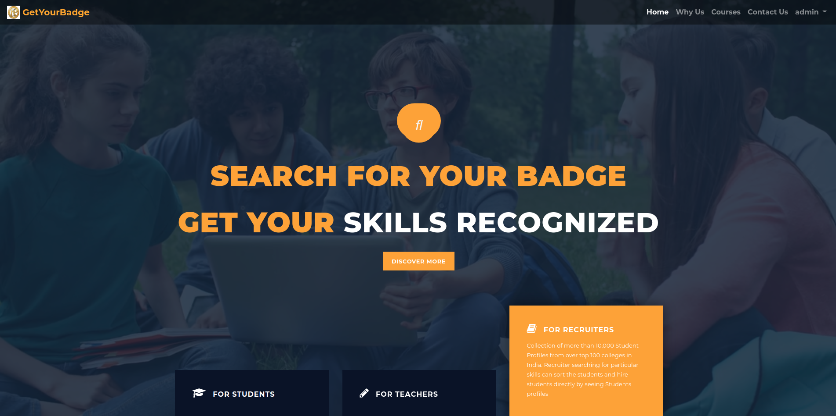

Slide 14
STAGE-III : FEASIBILITY AND USEABILITY
It will provide recruiters an opportunity to hire skilled and industry ready students through our portal.
They don’t need to be conducting recruitment processes which will save their resources and time.
It will provide students an opportunity to showcase their skills and get rewarded for their consistency.

Slide 15
STAGE-III : FEASIBILITY AND USEABILITY
This idea (project) fits well within present realms of working of hiring so it can be an asset for colleges as it will provide wide reach to students apart from available sources like LinkedIn portal, Internshala, TPO office, etc.
The students getting a token of appreciation for studying college courses sincerely can enhance their skill set.

Slide 16
BADGE
The generated badge will contain
Name of student
Date on which badge is allotted
course in which student is enrolled
QR-code generated on the basis of email id and URL of badge file.
(On scanning the badge on will be redirected to badge file on our portal)

Slide 17
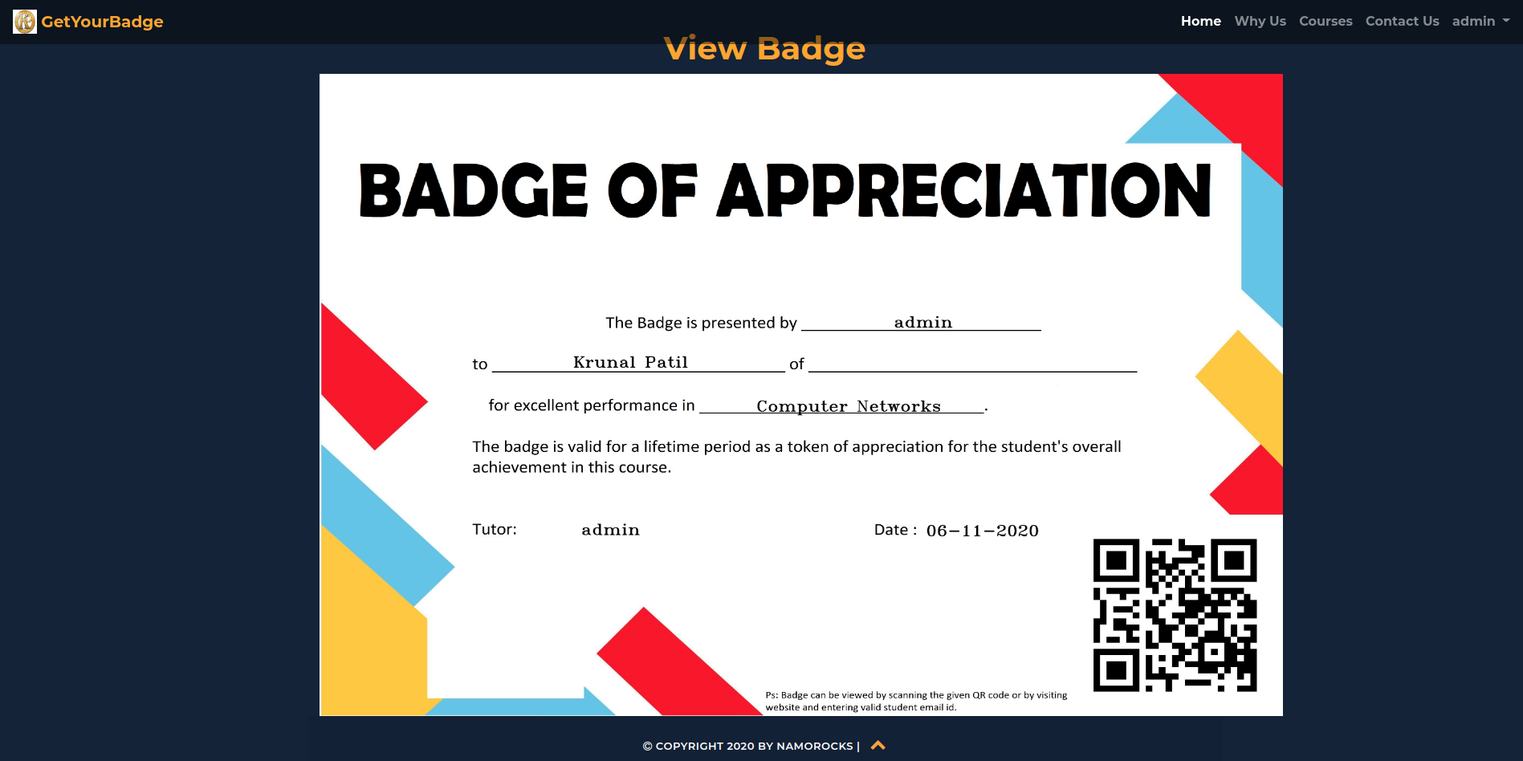

Slide 18
Future aspects of our project:
Add Student profile wherein one can display all allotted badges, resumes, courses mastered, ratings of various Coding platforms, any other achievements, etc.
So recruiters can visit and check the overall progress of student from our platform itself.
Recruiters can message teachers, TPO’s, Students from our site and get in touch for better connection further.

Slide 19
Coming to the technical aspects of project
Technology, architecture used:
Django-3.1.2
Python-3.5.8
PiP libraries used:
django-allauth==0.43.0
django-crispy-forms==1.9.2
opencv-python==4.4.0.44, Pillow==8.0.1
qrcode==6.1
Database Used:
DB-SQlite3

Slide 20
HEAD OVER TO WEBSITE PORTAL

Slide 21
From team “namoRocks” Krunal Patil Swapnil Singh Suraj Kekan
THANK YOU

